Slide 1
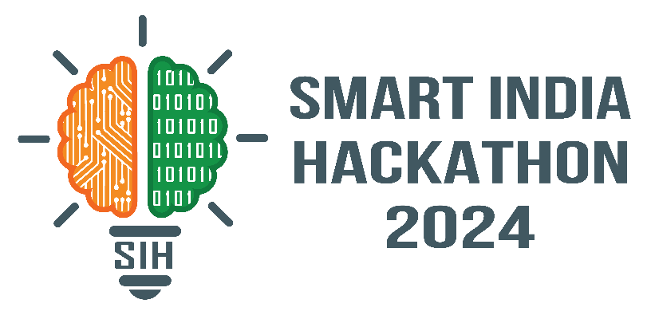
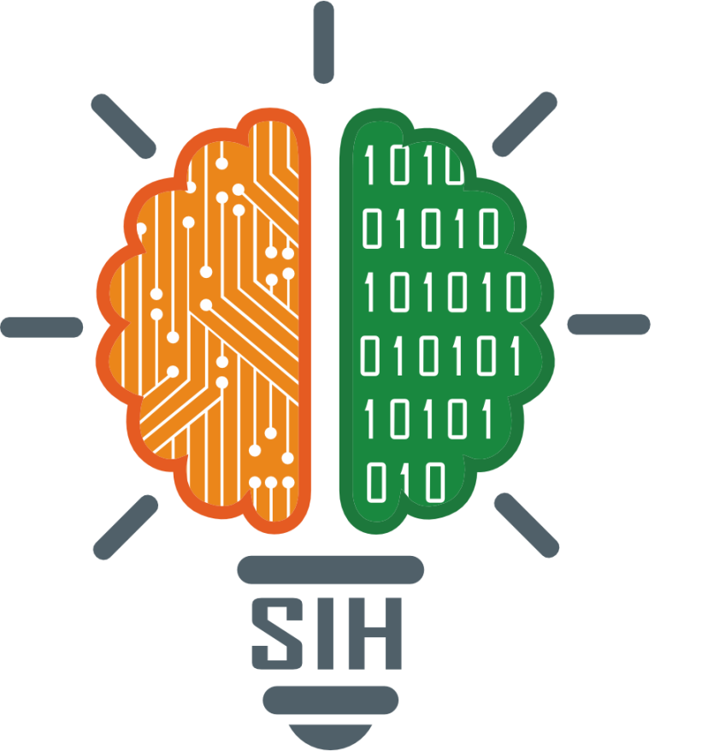
SMART INDIA HACKATHON 2024
TITLE PAGE
Problem Statement ID – 1571
Problem Statement Title- Drone based Intelligent ET Sensing System and Irrigation Water Use Accounting System
Theme- Robotics and Drone
PS Category- Hardware
Team ID-
Team Name (Registered on portal)

Slide 2
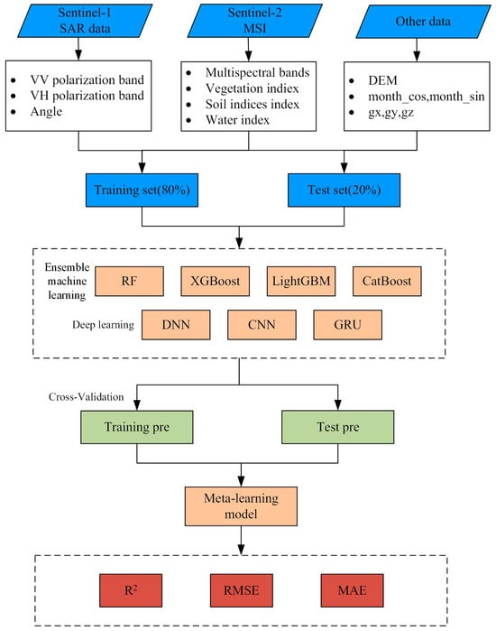
Proposed Solution: Drone-based ET Sensing System
Your Team Name
Addressing Irrigation Water Use with AI & ML
• Detailed Explanation: The drone-based system estimates Actual Evapotranspiration (AET) using AI/ML models. It calibrates with satellite data for accurate water use management at farm levels. • How It Addresses the Problem: Bridges the gap caused by satellite data limitations under cloudy conditions. Provides more precise water auditing through real-time data collection. • Innovation and Uniqueness: This solution uniquely integrates drones, AI, and satellite calibration to create real-time, precise farm-level water control systems.

Slide 3
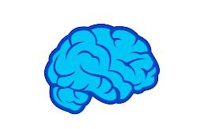


TECHNICAL APPROACH
Your Team Name
Machine Learning model training Using TensorFlow and Python, machine learning models will process real-time drone data to optimize AET measurements for farm-level control.
Using esp32 and micro-python and tiny ml administering
Drone and Sensors
Equipped with multispectral and thermal sensors, drones will capture key crop and irrigation data, integrated with satellite- based ET inputs.
Using the LST model to calculate AET in real-time.
Real-time KPI Monitoring Data collected by drones calibrated with satellite ET inputs to generate farm-level KPIs and water audits.
AI-driven analytics will provide insights like crop type, irrigation needs, and water use, helping farmers make informed irrigation decisions.

Slide 4
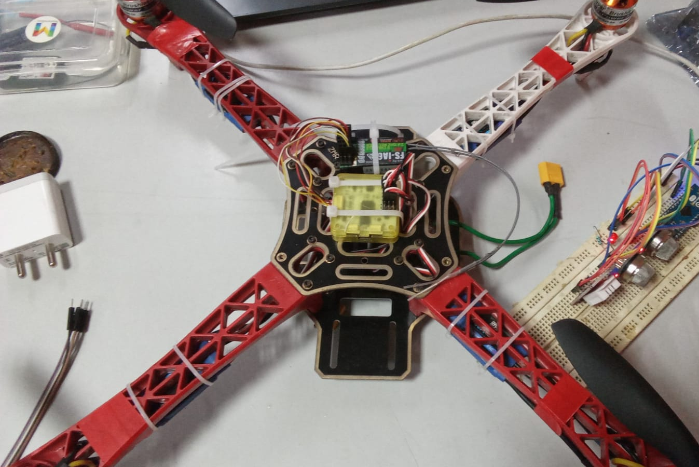
FEASIBILITY AND VIABILITY
Your Team Name
• High feasibility with AI and drone technology: Combining drones with AI/ML algorithms allows precise irrigation control and is scalable to large farm areas, from 50 to 5000 hectares.
• Challenges In Drone Adoption :
Integrating thermal and multispectral sensors on drones requires robust
calibration and may pose operational challenges in varied field conditions.
Dashboard integration and onboard machine learning training from the
data got from the sensors. • Overcoming challenges:
Calibrating drone data with satellite ET measurements and AI models improves accuracy and compensates for environmental conditions.
Using Esp32 for machine learning (using Micro-python and TinyML), and dashboard.

Slide 5




IMPACT AND BENEFITS
Your Team Name
Social Benefits
Increases farmer awareness of water usage and promotes sustainable irrigation practices . Farmers can make informed decisions about irrigation, reducing water waste .
Higher agricultural productivity:
Optimized irrigation leads to better crop yields, improving food security and supporting economic growth in farming regions.
Environmental conservation:
By reducing over-irrigation, the system helps mitigate the environmental impacts of water overuse, such as soil degradation and aquifer depletion.
Economic Benefits Optimizes water use, leading to cost savings for farmers and better crop yields, and improved crop quality, increased profits, and environmental sustainability.

Slide 6
RESEARCH AND REFERENCES
Your Team Name
https://www.researchgate.net/publication/362397182_Applications_of_Drones_in_Agriculture_Status_and_Scope
https://pubs.aip.org/aip/acp/article-abstract/2030/1/020308/729474/Progress-on-drone-technology-and-their
https://scholar.google.co.in/scholar_url?url=https://ageconsearch.umn.edu/record/208411/files/H046807.pdf&hl=en&sa=X&ei=VhvkZsXJK_-_6rQP96-jsAQ&scisig=AFWwaebGd96s2_3YyOPFSM18nKl5&oi=scholarr
https://www.nature.com/articles/s41597-021-00964-1
https://www.mdpi.com/2073-445X/13/8/1331

